Slide 1
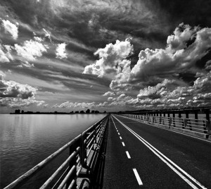
One point perspective is defined as a straight on view with only one vanishing point. Parallel lines converge on one point in the distance known as the vanishing point.
One Point Perspective

Slide 2
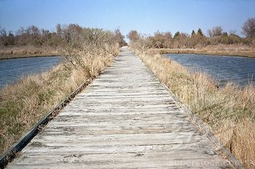
Notes:
Here are some photographs of examples of one point perspective

Slide 3
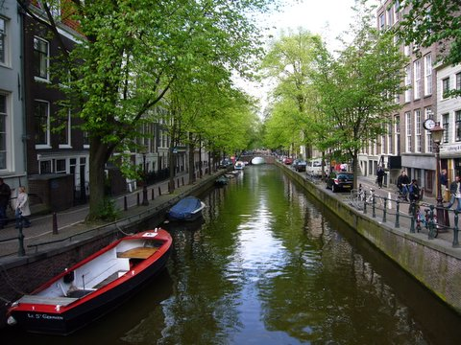

Slide 4
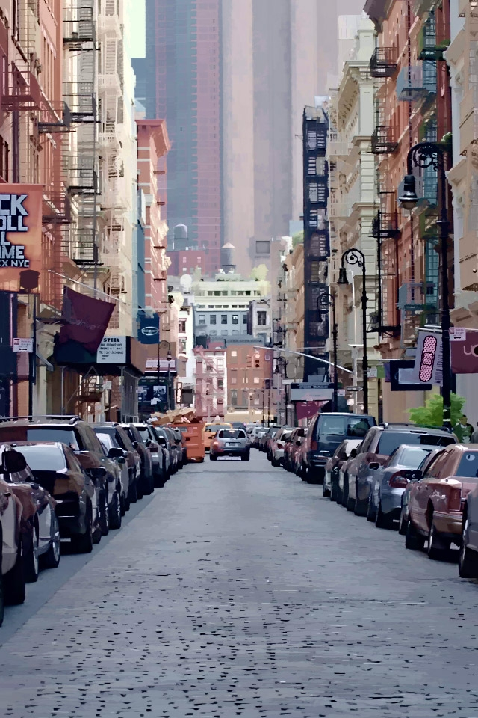

Slide 5
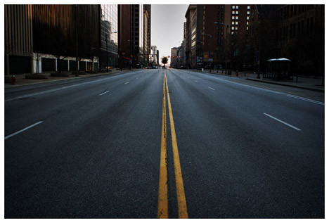

Slide 6
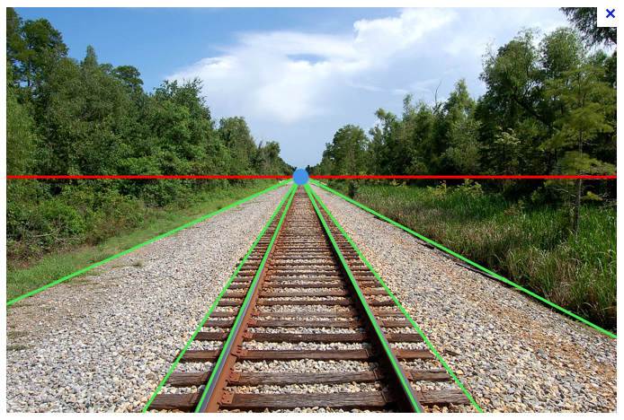
The VANISHING POINT is the dot on the horizon line (red) where parallel lines (green) seem to converge and disappear.

Slide 7
SPACE
The art element that refers to the area between, around, under, over and within objects. Space defines shapes and forms and the relationship between them.

Slide 8
Some ways to define SPACE:
Horizon line – line where sky and ground appear to meet.
Background – The area of a picture that appears to be farthest from the viewer. The background usually appears higher up on the picture plane (the flat surface of a painting or drawing).
Foreground – The part of the picture plane that appears closest to the viewer. The foreground begins at the bottom of the picture.
Middle ground – Area in the picture plane between the foreground and the background.

Slide 9
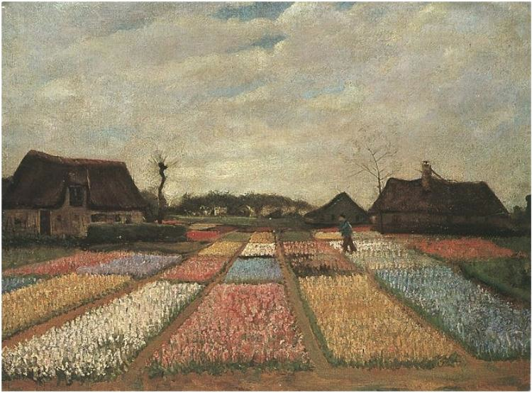
Bulb Fields by Vincent van Gogh
Painting, Oil on Canvas on panel
The Netherlands: April, 1883
National Gallery of Art, Washington D.C.
Notes:
Here is an example of a painting using this perspective done by the famous artist Van Gogh. This is of tulip field in the Netherlands where he lived part of his life.

Slide 10
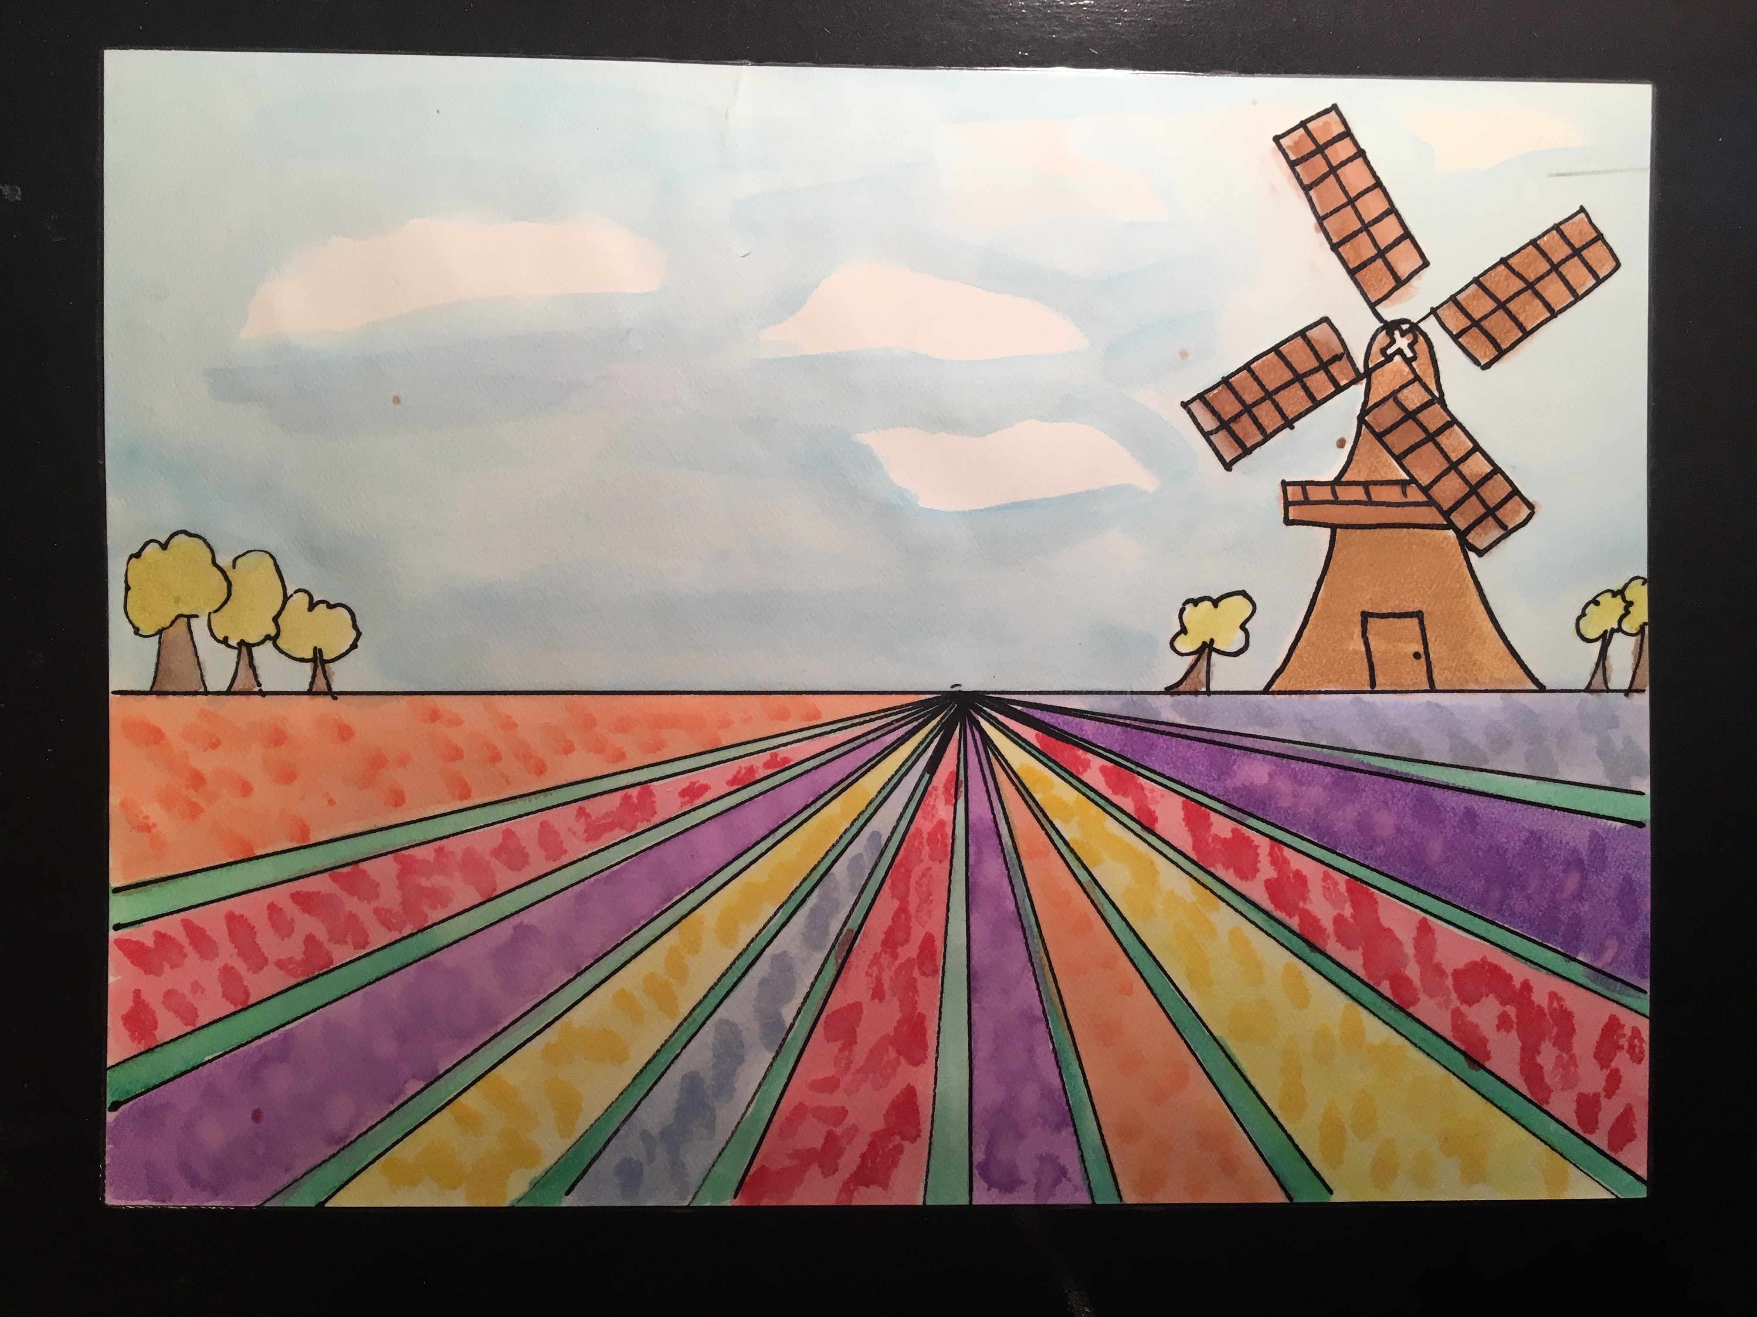

Slide 11
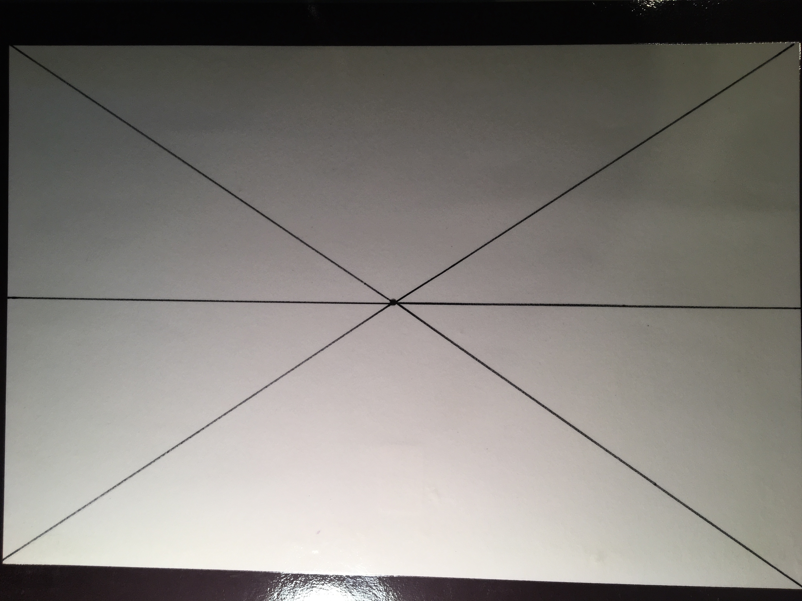
Step 1 Lightly with pencil: 1) Draw an “X” from corner to corner of the paper. 2) Draw a dot in the middle of the “X” (vanishing point). 3) Draw a horizontal line through the middle of the paper, passing through the dot.
Notes:
DOCENT NOTE:
Supplies needed (kids have these in their desks except the paper, paint sets and 18 in rulers):
Water color paper
Pencils
Erasers
Black sharpies
Watercolor sets
18 “Rulers (or 12” rulers and long straight edge to make the “X”)

Slide 12
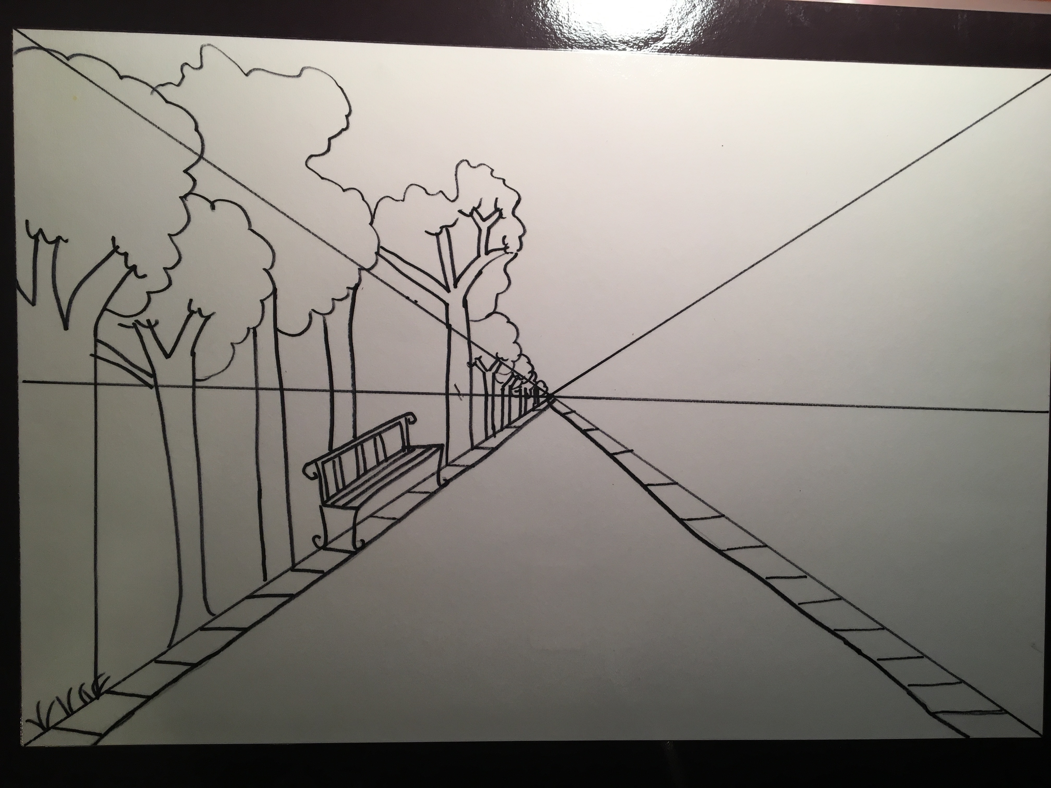
Step 2 (for drawing a city scene) Draw the sidewalks first from the vanishing point. Draw the trees starting on the bottom on the “X” all the way to the vanishing point, descending towards the middle. Make sure the trees are straight and parallel to the side of the paper. A trick to creating depth is to draw objects larger if they are closer and smaller if they are far away.
Notes:
Docent note - Make sure the trees are straight and parallel to the side of the paper. Watch students for this before they spend 20 minutes drawing 8 beautiful but very leaning trees and have to erase all of them!

Slide 13
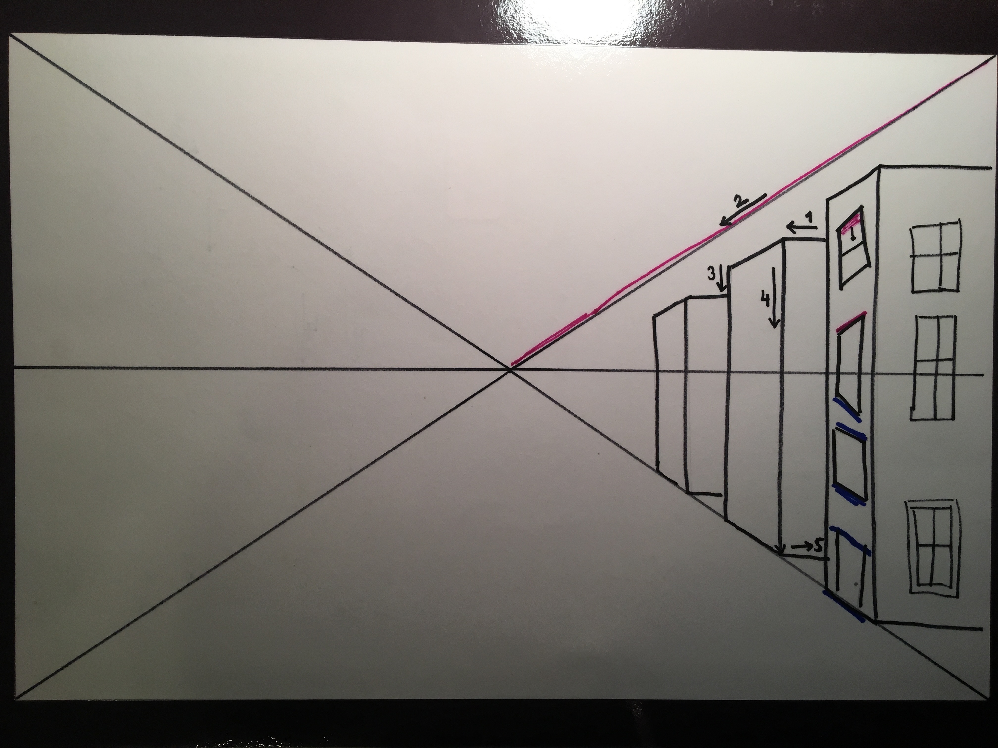
Step 3 To draw the buildings: #1 – draw straight out with a horizontal line for the side roof line #2 – draw diagonally down in line with the upper line of the “X” for roof line along front of building #3 –draw straight down with a vertical line to the ground #4 – draw straight down with a vertical line again #5 – draw horizontal line along bottom to create the bottom side

Slide 14
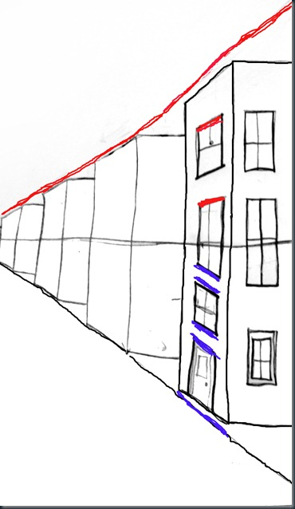
A tip when drawing windows: Start with the side with the door facing the street. The lines on the tops and bottoms of the windows ABOVE the horizon line are parallel to the top part of the “X”…….below that, when you PASS the Horizon line, the lines on the tops and bottoms of the windows are parallel to the BOTTOM part of the “X” which is now the sidewalk. The top of the door is also parallel to the sidewalk. RED parallel to RED and BLUE parallel to BLUE The windows on the OTHER side of the house are normal right angle squares or rectangles.

Slide 15
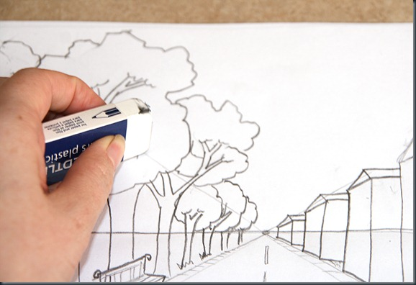
Now erase the “X” and the parts of the horizon line that overlap the trees and buildings

Slide 16
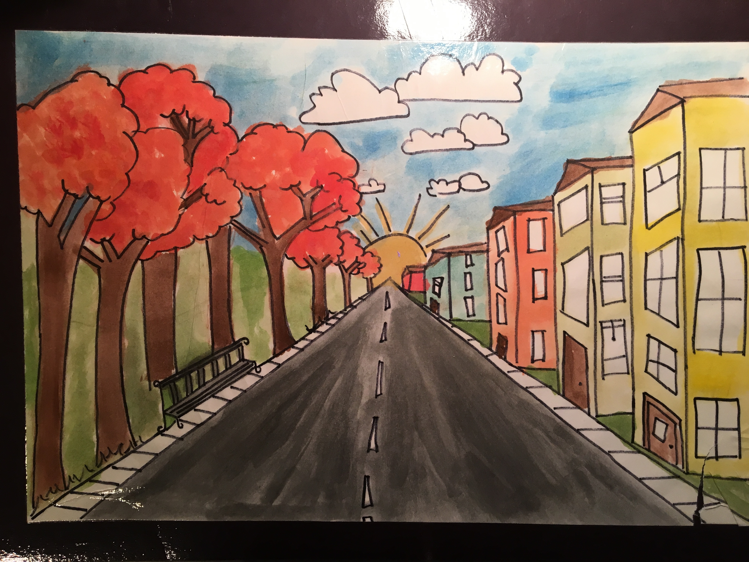
Step 4- Finish windows and add details.
Step 5 -Trace with sharpie and erase pencil lines (especially of horizon line and “X” if they are not part of your final painting)
Step 6 - Paint with watercolor

Slide 17
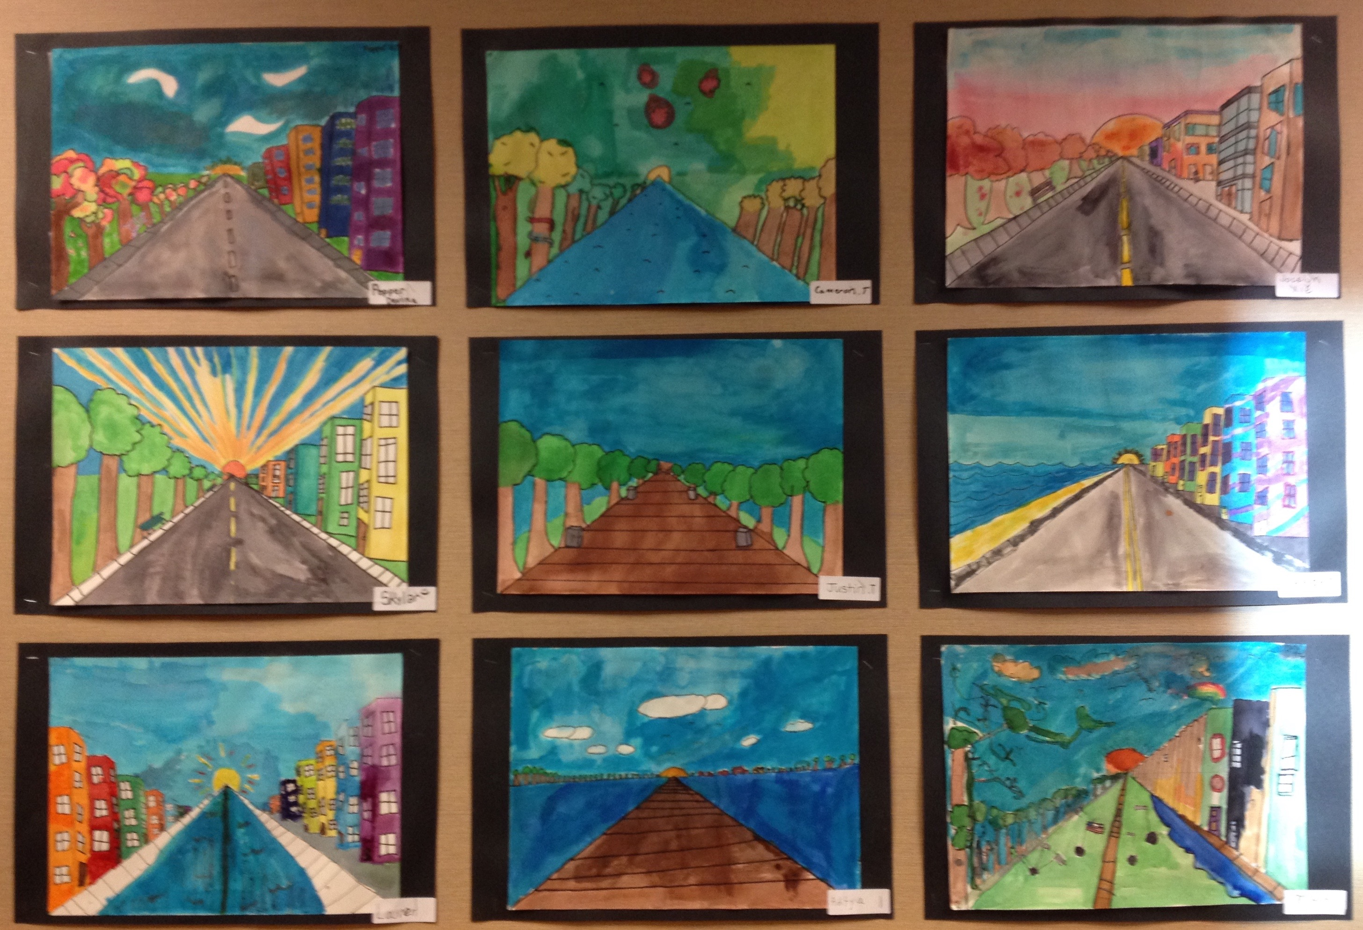
Examples of student art
Notes:
Artwork from students at Creekside Elementary

Slide 18
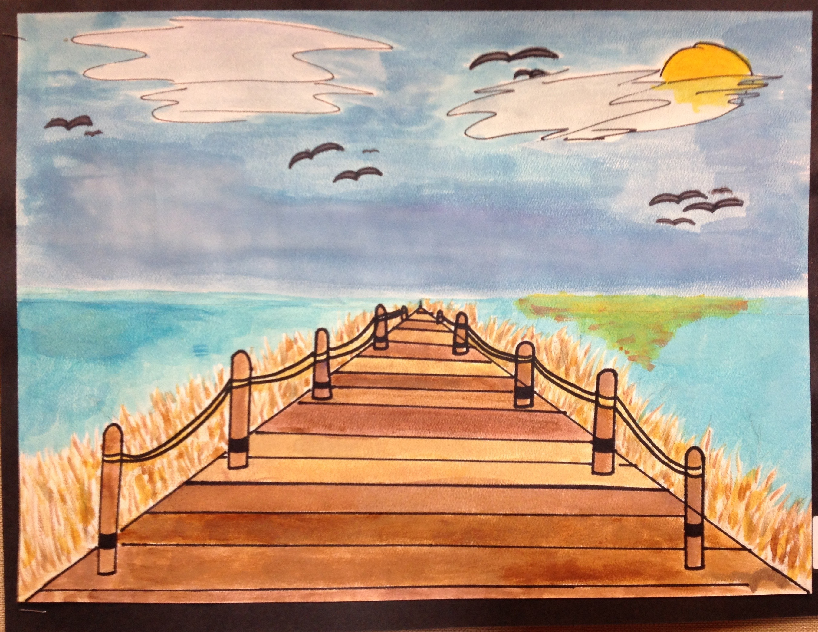
Example of student art with a non-city scene
Notes:
Artwork from students at Creekside Elementary

Slide 19
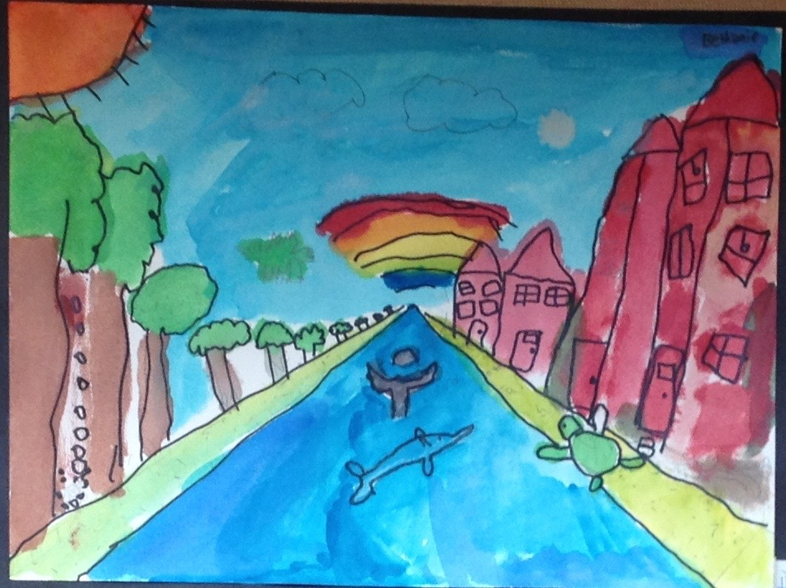

Slide 20
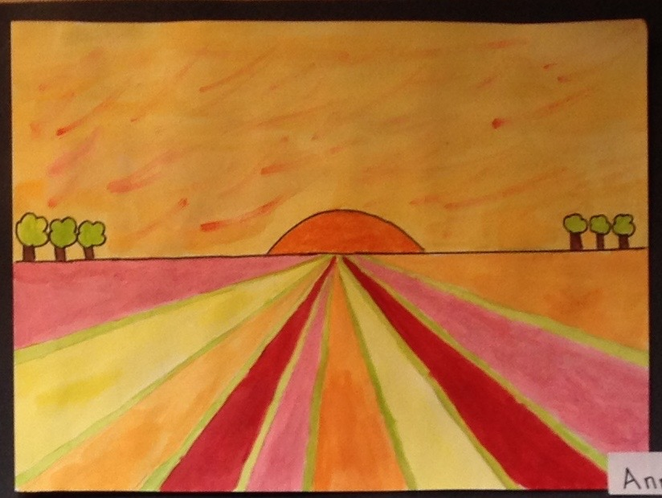
Notes:
Artwork from students at Creekside Elementary

